Slide 1
Refining Computer Sales Strategy through Statistical Analysis Project
Mentor: Munna Pandey
submitted by: S. Pratheek
Wave number:4777
Batch Number:da374S37

Slide 2
Enhance Product Strategy and Sales Performance
Probability of Selling Premium Computers
import numpy as np
import pandas as pd
data = pd.read_csv(r'/content/DS1_C8_Computers_Data_Project.csv')
premium_computers = data[(data['premium'] == 'yes')]
number_of_premiumcomputers = len(premium_computers)
probability_1 = number_of_premiumcomputers/total_computers
print(f"Total number of premium computers: {number_of_premiumcomputers}")
print(f"Number of computers meeting the criteria: {number_of_premiumcomputers}")
print(f"Probability of purchasing such a computer: {probability_1:.2f}")
Output:
Interpretation:
The probability of purchasing such a computer is 0.90 is calculated by filtering the data by yes in premium the data is preprocessed and cleaned completely

Slide 3
.
Given that a computer is premium, what is the probability that it has a CD player?
premium_cd_computers = data[(data['premium'] == 'yes')&(data ['cd']=='yes')]
no_of_premium_cd_computers = len(premium_cd_computers)
probability_of_premiumcdcomputers = no_of_premium_cd_computers/number_of_premiumcomputers
Probility_of_selecting_premium_cd_computers = (probability_1*probability_of_premiumcdcomputers)/probability_1
print(f"Probability of purchasing such a premium computer with cd player: {Probility_of_selecting_premium_cd_computers:.2f}")
Output:
Interpretation:
The task is done using conditional probability because the cd should be selected after the premium computer is selected.
so, the intersection of cd and premium divided by probability of premium computer.
The purchasing such a computer is 0.50

Slide 4
.
Predicting the Probability of Certain Specifications
Given that a computer is not premium, what is the probability that it has a screen size less than or equal to 14 inches?
non_premium_computers = data[(data['premium'] == 'no')]
no_of_non_premium_computers=len(non_premium_computers)
nonpremiumcomputers_size_lessEqual_to_14 = data[(data['premium'] == 'no')&(data ['screen']<=14)]
no_of_nonpremiumsize14=len(nonpremiumcomputers_size_lessEqual_to_14)
Probability_of_non_premium_computer_sizelessthanEqucal_to_14 = no_of_nonpremiumsize14/no_of_non_premium_computers
print(f"Probability of non premium computer sizelessthanEqucal to 14: {Probability_of_non_premium_computer_sizelessthanEqucal_to_14:.2f}")
Output:
Interpretation:
The task is done using conditional probability because the cd should be selected after the non premium computer is selected is filtered from data using premium = no
The intersection of screen less than equal to 14 and non premium divided by probablity of premium computer.
The probability of non premium computer size less than equal to 14 15screen size: 0.69

Slide 5
.
i.What is the joint probability of computers having both a CD player and a multimedia kit?
computers_cd_multimedia = data[(data['cd'] == 'yes')&(data ['multi']=='yes')]
count_of_computers_cd_multimedia= len(computers_cd_multimedia)
probaility_of_computers_have_both_cd_multimedia = count_of_computers_cd_multimedia/total_computers
print(f"Joint probaility of computers have both cd multimedia: {probaility_of_computers_have_both_cd_multimedia:.2f}")
Output:
Interpretation:
The joint probability is calculated by the common computers have cd and multi media by all computers.The joint probability of computers have both cd multimedia: 0.13
ii.Given that a computer has a CD player, what is the probability that it also has a multimedia kit?
computers_cd_multimedia = data[(data['cd'] == 'yes')&(data ['multi']=='yes')]
count_of_computers_cd_multimedia= len(computers_cd_multimedia)
cd_computers = data[(data['cd'] == 'yes')]
no_of_cd_computers=len(cd_computers)
probaility_of_cd_computers_multimedia = count_of_computers_cd_multimedia/no_of_cd_computers
print(f"Probaility of cdcomputers having multmedia: {probaility_of_cd_computers_multimedia:.2f}")
Output:
Interpretation:
The probability here is conditional probability here the common computer have both cd and multimedia divided to the probability of comupters with cd.The probability of computers with multimedia already having cd in them is 0.30

Slide 6
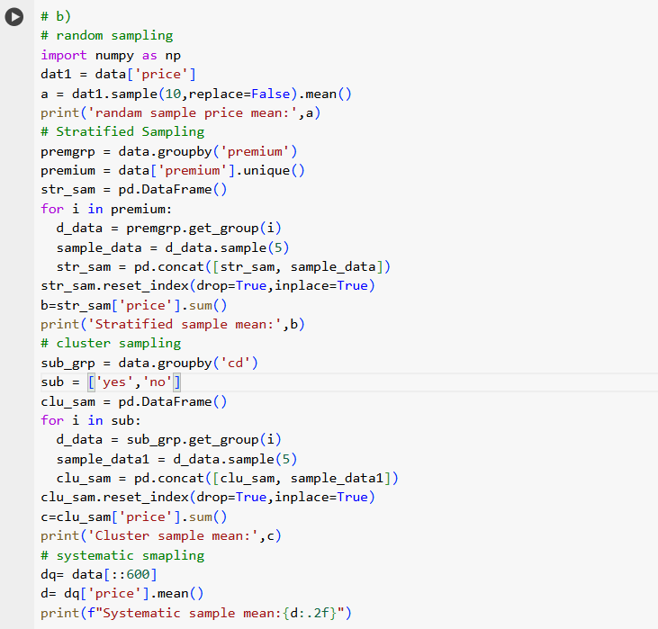

Assessing Price Disparities Between Premium and Non- Premium Computers
How does the average price of samples vary when data is sampled using different sampling techniques?
Output:
Interpretation: The mean in each type of sample isdifferent from other ramdomsample mean and cluster sample have little difference ,stratified sample and systemic have little difference but eventually there are differences in each different sample mean

Slide 7

How does the average price differ between premium and non-premium computers of sampled data using simple random sampling without replacement?
premiumcom_totalprice = data.loc[data['premium']=='yes']
non_premiumcom_totalprice= data.loc[data['premium']=='no']
average_priceof_precomputers = premiumcom_totalprice['price'].mean()
average_priceof_non_precomputers = non_premiumcom_totalprice['price'].mean()
s100 = premiumcom_totalprice.sample(100,replace=False,random_state=1).sort_index()
n100 = non_premiumcom_totalprice.sample(100,replace=False,random_state=1).sort_index()
print(f"Aveage price of premium computers: {average_priceof_precomputers:.2f} ")
print(f"Aveage price of 100 premium computers samples: {s100['price'].mean():.2f} ")
print(f'Average price of non premium computers:{average_priceof_non_precomputers:.2f}')
print(f"Average price of 100 non premium computers samples:{n100['price'].mean():.2f}")
Output:
Interpretation:
The means of prices of premium and its sample ,non premium and its sample have so light difference it can be said its lowly approx. same may be it has a slight difference in plots It can be said the sample i have got match almost the same characteristics as the original population data.

Slide 8
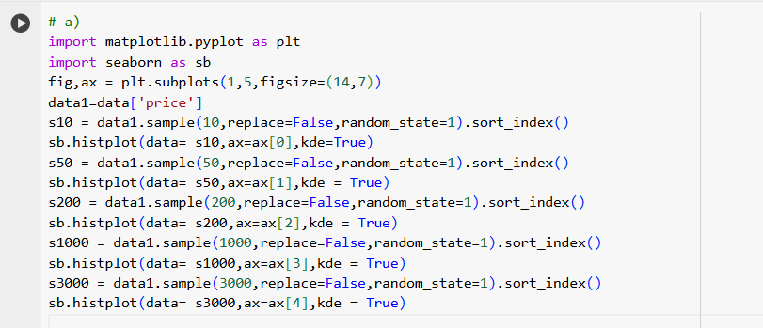
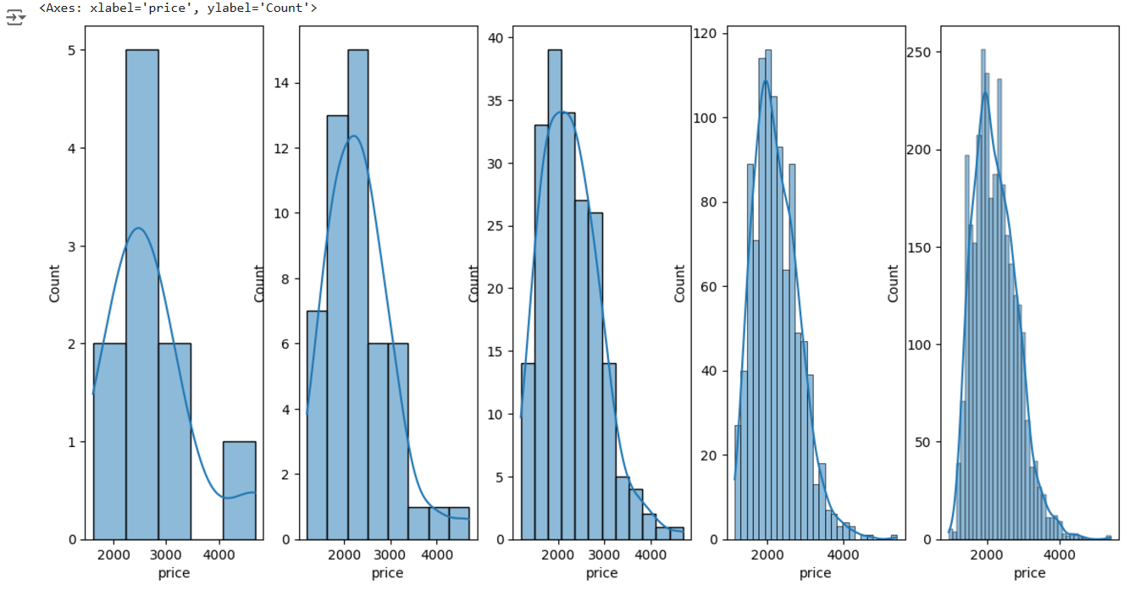
Understanding Computer Price Trends Through Distribution Analysis
How does the distribution of sample means change for computer prices with different sample sizes?
Output:
Interpretation: The distribution of a sample change by increase in sample size and from the above samples distribution its seen that the distribution nearly becomes normal distribution as size increases

Slide 9
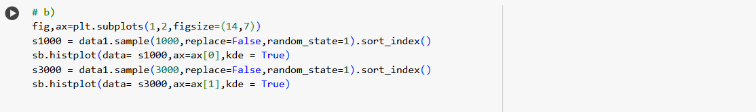
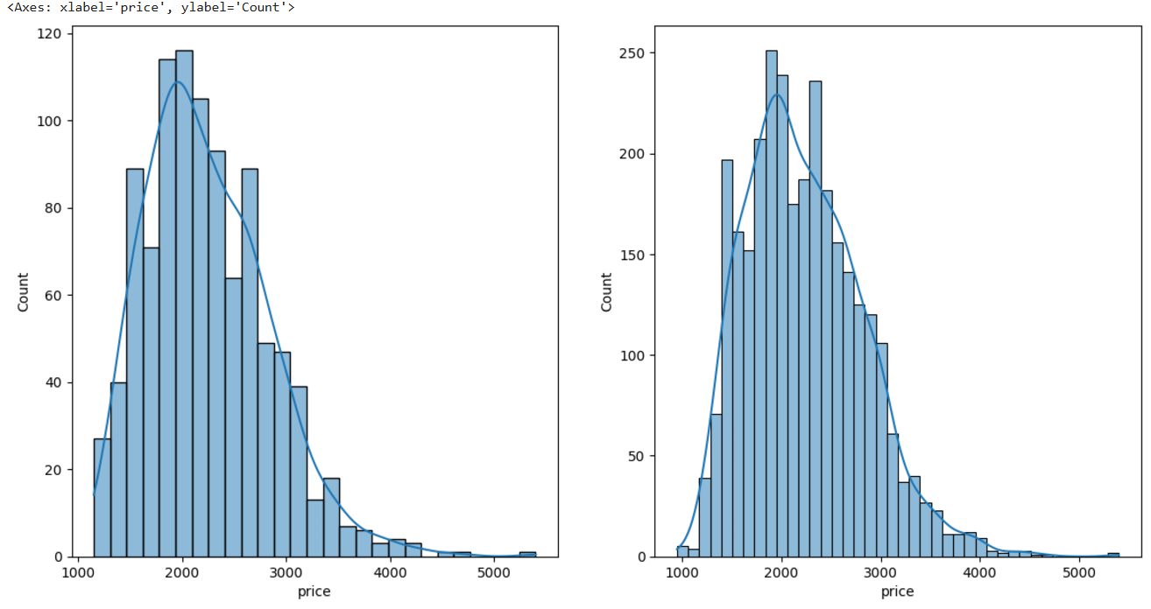
.
Does the distribution of sample means approximate a normal distribution as sample size increases?
Output:
Interpretation:
Yes, the distribution of sample means approximate a normal distribution as sample size increases
The visualization clearly visualize the distribution of high sample sizes is nearly normal

Slide 10
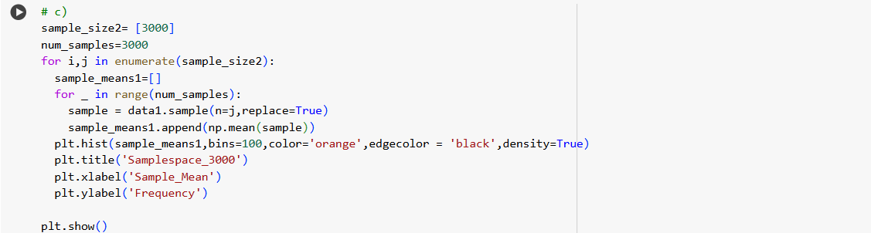
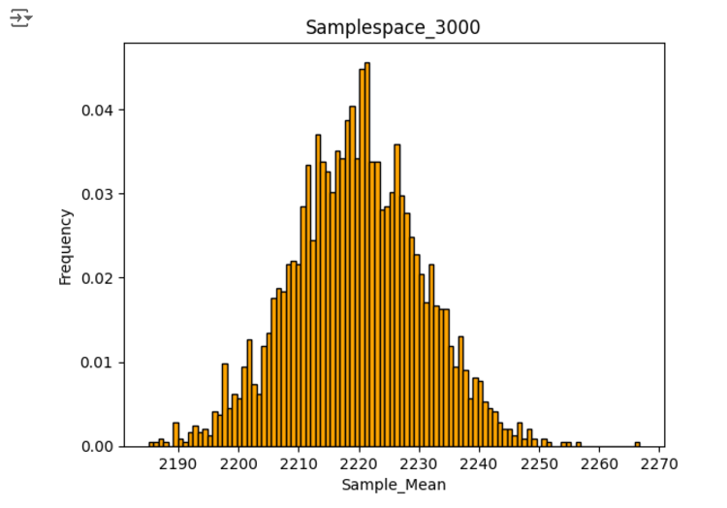
.
Check if properties of Central limit theorem for the samples is satisfied
Output:
Interpretation:
Yes properties of Central limit theorem for the samples is satisfied it can be confrim from below distributed visualization of sample of size 3000.

Slide 11
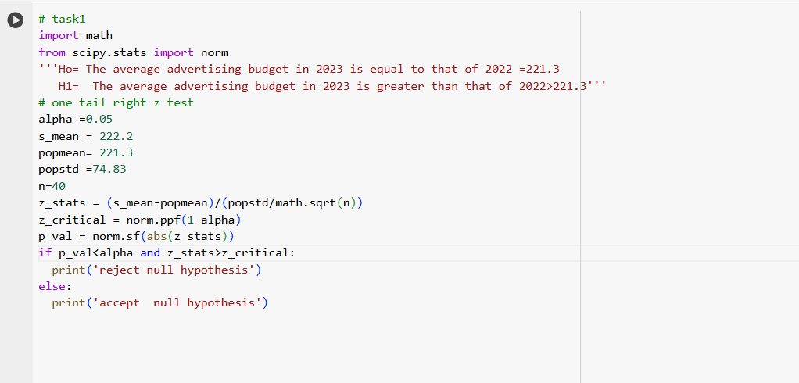

Analyzing Advertising Budget for Premium Computers by Identifying Budget Allocation.
Output:
Interpretation:
The null hypothesis is accepted the average advertising budget in 2023 is equal to 221.3 it has not been increased

Slide 12
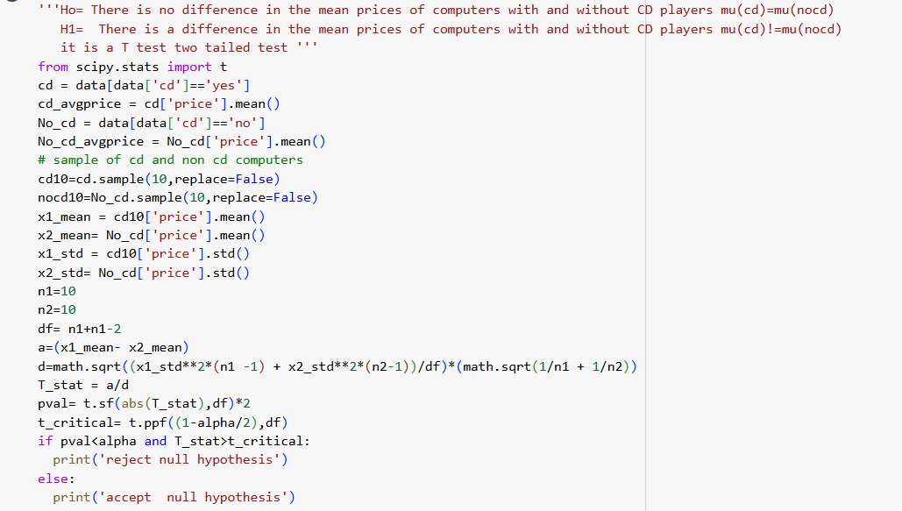
Evaluate the Price Difference between Computers with and without CD Players
Output:
Interpretation:
The null hypothesis is accepted , alternate hypothesis is rejected There is no significant difference in mean prices of computer with cd and computers with no cd

Slide 13
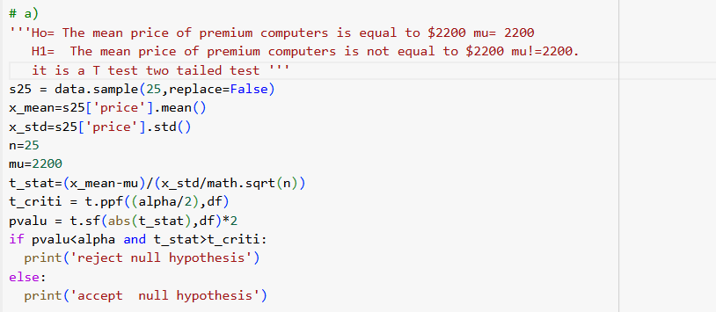

Analyse Premium Computer Pricing Strategy
Determine if the mean price of premium computers differs significantly from $2200?
Output:
Interpretation:
The null hypothesis is accepted , alternate hypothesis is rejected. The data does not provide sufficient evidence to conclude that the mean price differs from $2200.

Slide 14
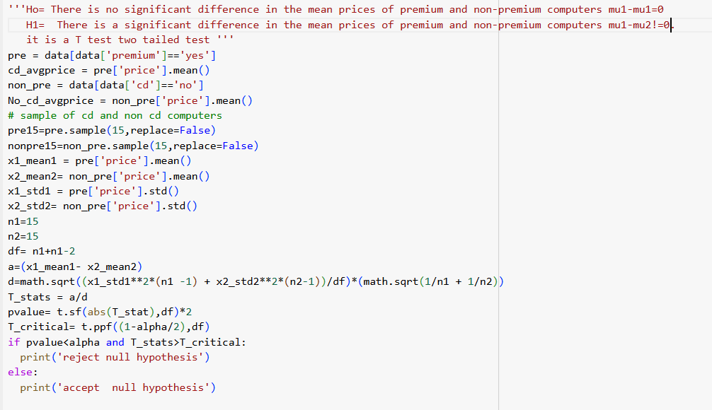
.
Output:
Interpretation:
The null hypothesis is accepted , alternate hypothesis is rejected. There is no significant difference in the mean prices of premium and non-premium computers

Slide 15
Summary and conclusion
The probability of purchasing premium computer is 0.9
The probability that it has a CD player and premium computer id 0.5
The probability of computers with multimedia already having cd in them is 0.30
The mean in each type of sample is different from other samples.
The distribution curves of a sample change by increase in sample size
The distribution of sample means approximate a normal distribution as sample size increases
The properties of Central limit theorem for the samples is satisfied it can be confirm from below distributed visualization of sample of size 3000.
Conclusion:
The average budget of adverting for 2023 has not increased , it is same as 2022
The both computers with cd and without cd players have no significance difference between there average mean prices
The both computers premium and non premium computers have no significance difference between there average mean prices
This conclusion and hypothesis test provide understanding sales of computer , it also specifies to work on strategy computers with cd and premium to increase average prices and computers with less specifications

